Slide 1
SMEM Algorithms (Implementation)

Slide 2
Project Goals
To get knowledge about different types of algorithms and their working and implementation.
To determine which algorithm works best in which conditions.
To provide a better, and user friendly interface for the calculations of scheduling processes.

Slide 3
Description
This is a GUI based project which provides user a friendly environment to switch between processes and calculate the results from their desired algorithm along with features of clear and delete the record.
The project is divided into two main categories:
Process Scheduling Algorithms
Memory Allocation Algorithms

Slide 4
Process Scheduling
Activity which selects the order of processes to be executed based on different conditions and scenarios.
Scheduling algorithms
A Process Scheduler schedules different processes to be assigned to the CPU based on particular scheduling algorithms, algorithms implemented in this project are:
First-Come-First-Serve(FCFS)
Shortest-Job-First(SJF)
Round Robin(RR)

Slide 5
Process Scheduling
First-Come-First-Serve(FCFS)
Implementation is based on FIFO queue.
Jobs are executed on first come, first serve basis.
Shortest-Job-First(SJF)
Executes the shortest job first.
Best approach to minimize waiting time.
Round Robin(RR)
Each process is provided a fix time to execute, it is called a quantum.
Context switching is used to save states of preempted processes.

Slide 6
Memory Allocation
Process of deciding which processes will get memory resources and when.
Memory Allocation Method
This project uses ‘Partition Allocation Method’ which is divided into following processes:
First Fit
Next Fit
Best Fit

Slide 7
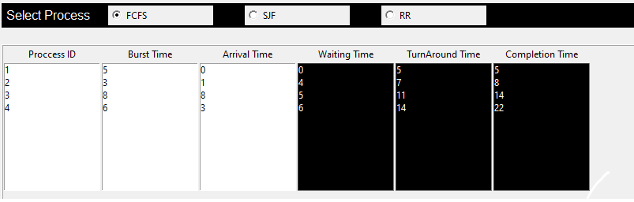

Analysis Of Different Process Scheduling Algorithms
First-Come-First-Serve(FCFS)

Slide 8
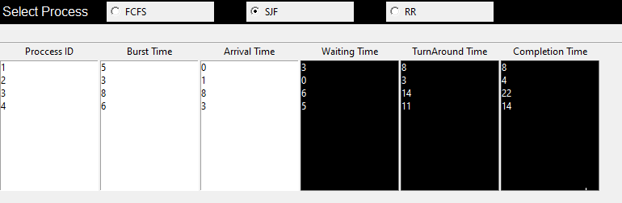

Analysis Of Different Process Scheduling Algorithms
Shortest-Job-First(SJF)
Provides minimum average waiting time among all processes

Slide 9
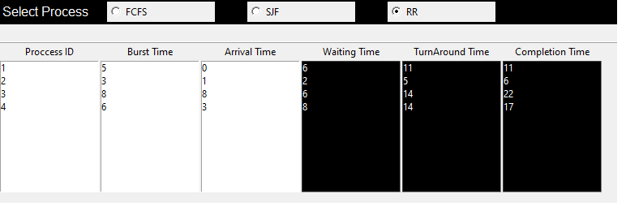

Analysis Of Different Process Scheduling Algorithms
Round Robin(RR)

Slide 10
Memory Allocation
First Fit:
It allocates the first free portion , or portion large enough to accommodate the process.
Best Fit:
searches whole list of available blocks.
tries to find the block closest to process size.
Next Fit:
begins as first fit to find a free partition.
next time , starts searching from where it left off.

Slide 11
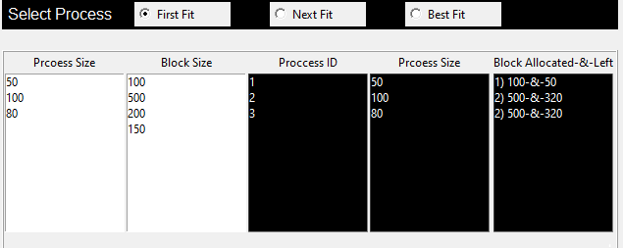
Analysis Of Different Memory Allocation Processes
First Fit:

Slide 12
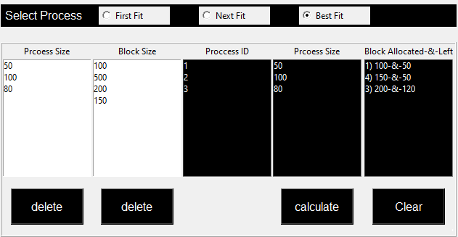
Analysis Of Different Memory Allocation Processes
Best Fit:

Slide 13
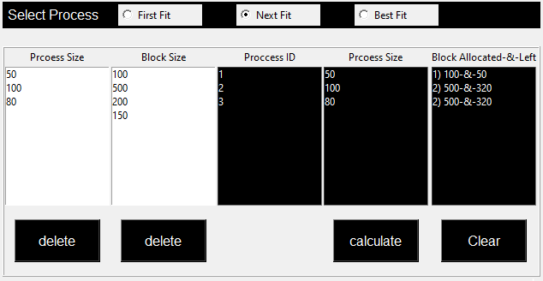
Analysis Of Different Memory Allocation Processes
Next Fit:

Slide 14
Team Resources
State assumptions about resources allocated to this project.
People
Equipment
Locations
Support & outside services
Manufacturing
Sales

Slide 15
Related Documents
Demo Video:

